Slide 1

Sprint 3 update: Telecoms churn prediction
By Mitchell McCallum

Slide 2

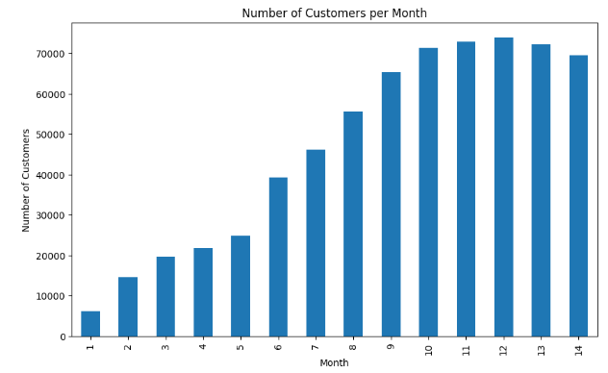
Stop Telecom Companies from Having customers Drained drip by drip….
Monthly churn of only 4.53% can erode a telecoms company’s customer base.
Harvard found a ratio of 1:5 for churn reduction: potential increase to gross profit^{[1]}
Attracting new customers to your service requires 6-7 times the amount of spending as it does to retain a customer^{[2]}

Slide 3




Random forest and neural networks + XGB to find the answer
74 features in the dataset
Over 900,000 rows over 91,000 customers
Label encoding object features
Imputing numeric, non numeric features
SMOTE and Undersampling
Splitting prior to Preprocessing to prevent Data Leakage

Slide 4
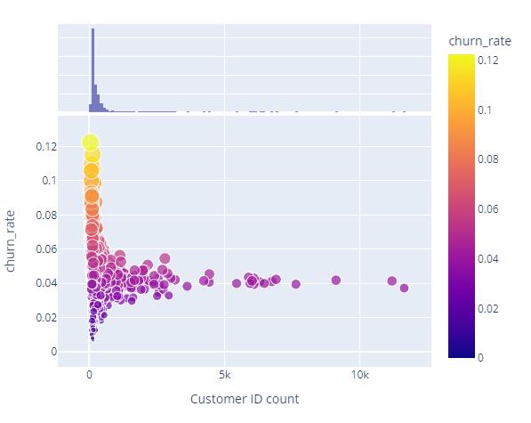
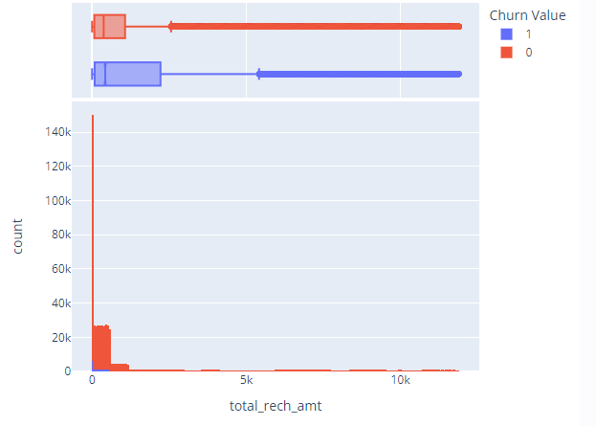
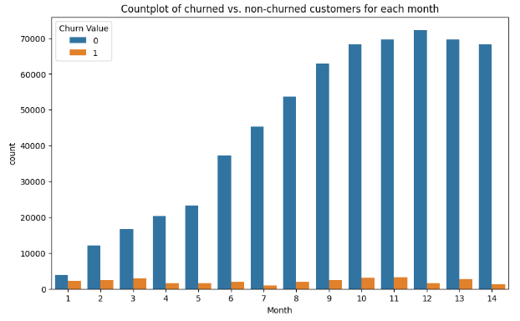
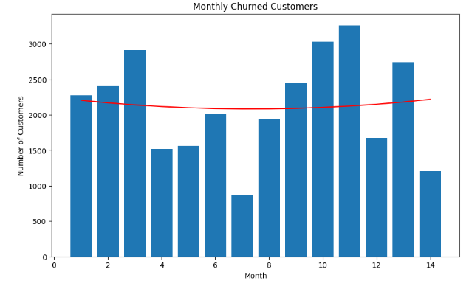
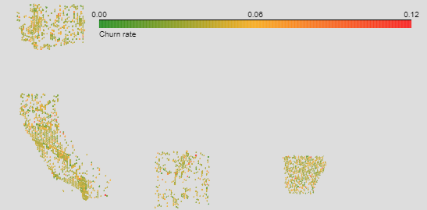
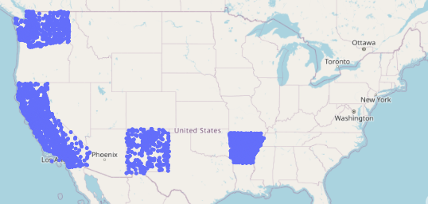
Data insights

Slide 5




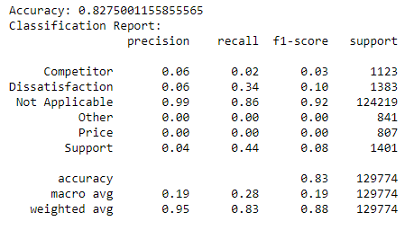
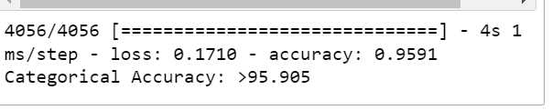
Model Results
Neural Network outperformed
Increasing Epochs didn’t have a major impact
Preprocessing steps for Neural Network
Not Encoded

Slide 6
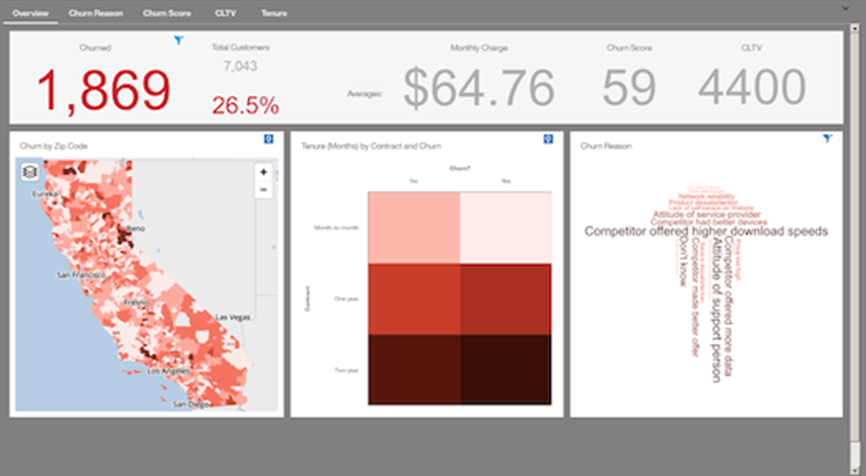
Enterprise dashboard
Business facing tool to help
Companies rapidly respond
to churn situation.
Potential to be integrated with customer app or CRM tools for the development and or deployment of ad campaigns.

Slide 7
Sources
https://vectalabs.com/the-impact-of-network-quality-on-churn-in-telecoms/
https://hbswk.hbs.edu/archive/the-economics-of-e-loyalty

